Slide 1
Lecture A02: CSHARP
Web Application Development & Project (ITP271)

Slide 2
C#
Object Oriented
Case sensitive
A strongly typed language
  Strict about data types

Slide 3
Features
Garbage Collection
Single super-classing
Interfaces
Exception
Byte code
Almost all features from Java, yet it has new features which Java is learning and implementing from learning from C#
  A good sign for the programming language

Slide 4
Variable Declaration and Type Conversion
string name = "John";
int age = 34;
Convert int to string:
  Label1.Text = age.ToString();
Convert string to 16 bit int:
  age = Convert.ToInt16("34");

Slide 5
Variable Declaration and Type Conversion
Other Convert methods:
  .ToInt32()
  .ToInt64()
  .ToDouble()
  .ToInt32()
  .ToDateTime()
  More…
  For details and more info, see: http://msdn.microsoft.com/en-us/library/system.convert.aspx

Slide 6
Operators
C# provides a large set of operators
Operator | Description
&& | Conditional AND
II | Conditional OR
new | Create new object
== | Equal
!= | Not equal
> | Greater than
< | Lesser than
>= | Greater than or equal
<= | Less than or equal

Slide 7
Operators
Example:
  if(user == "Zak" && itemsBought > 0)
  {
  // do process order…
  }
For more C# operators, see: http://msdn.microsoft.com/en-us/library/6a71f45d(v=VS.100).aspx

Slide 8
Conditional Logic
  if(userName.Text == "Zak") ✓
Common mistake
  if(userName.Text = "Zak") ✗
The above is incorrect:
  Single = is an assignment operator... we're setting the value of userName.Text to "Zak".

Slide 9
Conditional Logic
switch(userName) {
case "Zak":
Response.Redirect("ZakPage.aspx");
break;
case "Mark":
Response.Redirect("MarkPage.aspx");
break;
default:
Response.Redirect("ErrPage.aspx");
break;
}

Slide 10
Loops
Beside the common loops
  do while
  for
  while
We can use
  foreach
  Useful for iterating a collection

Slide 11
Collection Generic
Namespace: System.Collections.Generic
Create strongly typed lists that provide better type safety and performance than non-generic strongly typed Collections
Some common types of Collections
  Dictionary
  List
  For more types of Collections, see: http://msdn.microsoft.com/en-us/library/system.collections.generic.aspx

Slide 12
List
// create a List of string objects
List<string> listString = new List<string>();
listString.Add(“John”);
listString.Add(“Zak”);
// sort it
listString.sort();
// get first item
string first = listString[0];

Slide 13
foreach Loop
foreach(string name in arrayString)
{
if(name == “Zak”)
{
// do something…
}
}

Slide 14
Properties and Methods
Properties
  Hold specific information relevant to the class
  labelName.Text
Methods
  Also known as functions
  DateTime.Now.ToShortDateString();

Slide 15
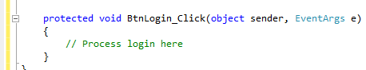
Properties and Methods
The following is a method implementation

Slide 16
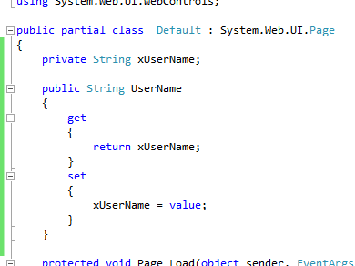
Properties and Methods
The following is a Property implementation
Name of property

Slide 17
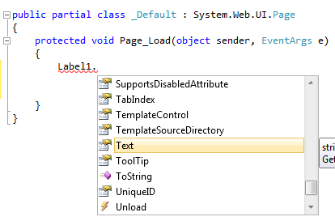
Properties and Methods
Visual Studio's Intellisense providing code hints: listing the available methods and properties.
Property icon
Method icon

Slide 18
Summary
Review of C#
  Property and Methods
  Generic Collection

